Slide 1
Mission: Possible
Cse 476 Project 3
Don Nakashima
ZhuoqUn Xia
Hongyu yan

Slide 2
GPS location-based game
Find the locations based off of the hints given on the screen
Within a certain location of each point, press the “check location” button to check in
You will get 25 points at each check-in if you are close enough
Get 100 points to win the game!

Slide 3
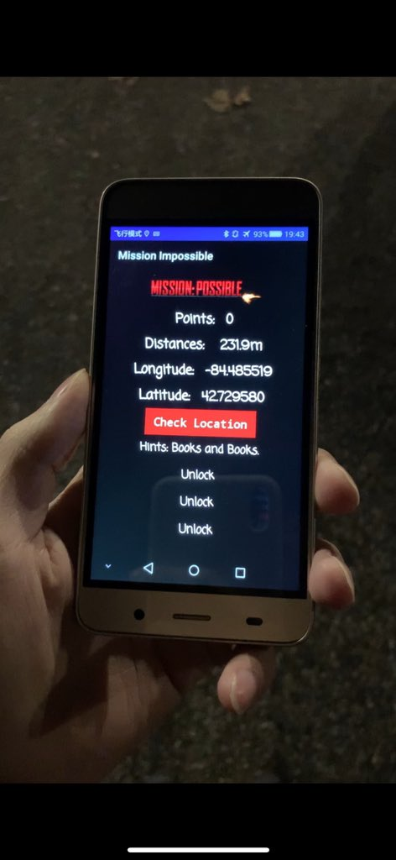

Slide 4
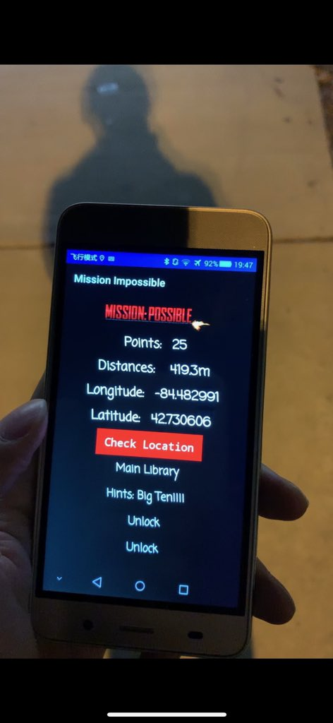
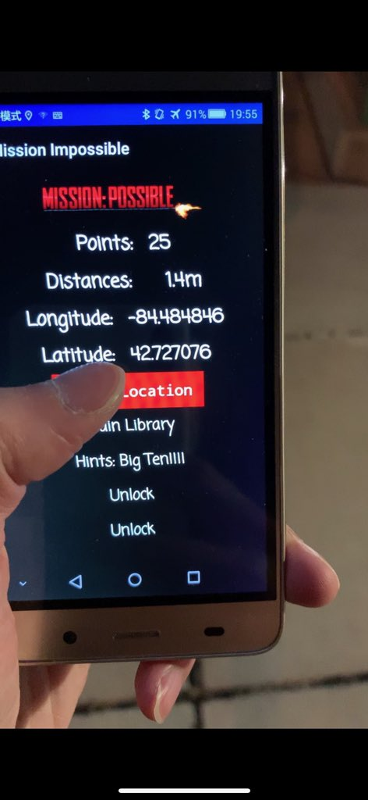

Slide 5
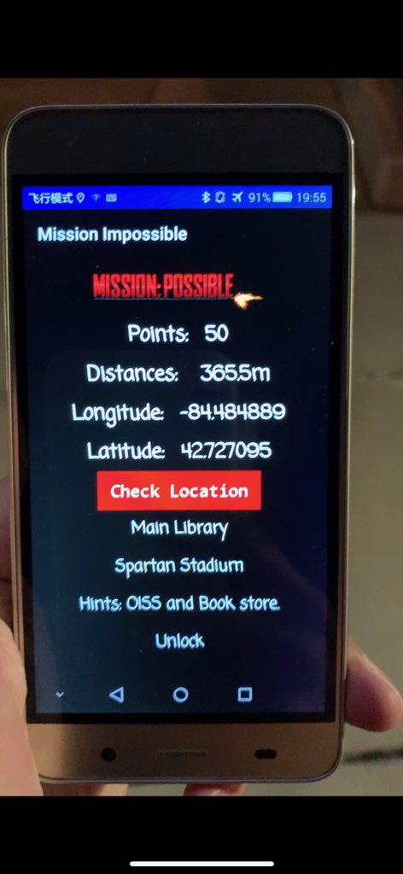
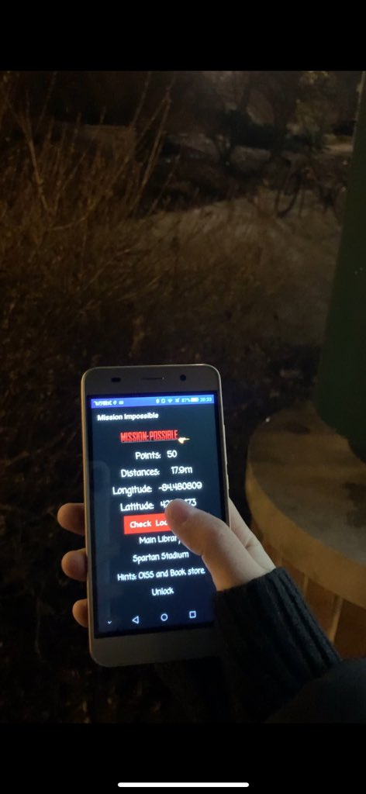

Slide 6
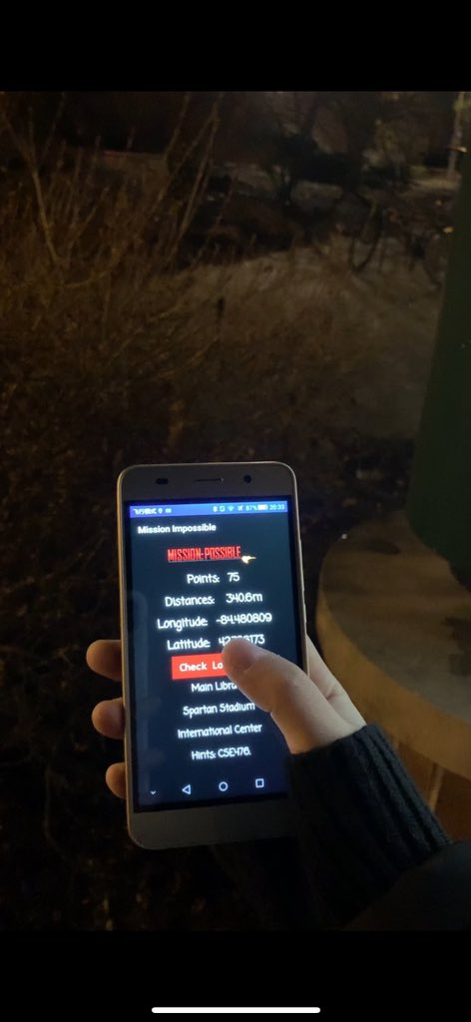
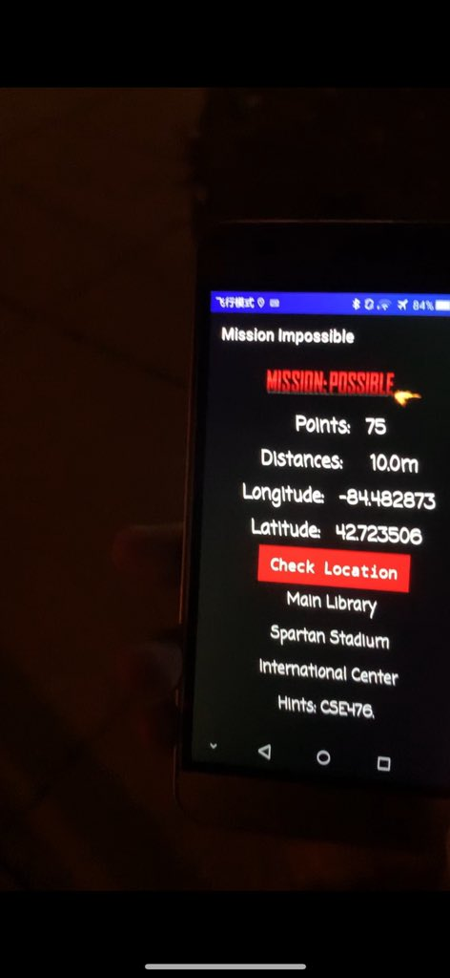

Slide 7
